Slide 1
Thyroid gland
Dr. Noor Sabeeh
2022/2023
References:
1.Robbins Basic Pathology
2.Pathology outlines

Slide 2
Learning objectives 1. Thyroiditis . 2. Goiter 3. Neoplastic lesions of the thyroid gland

Slide 3
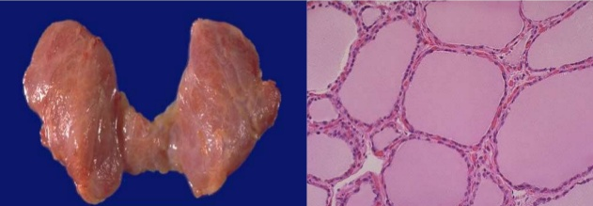
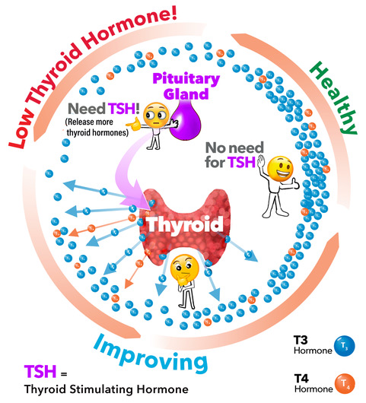

Slide 4
Those associated with excessive release of thyroid hormones Hyperthyroidism
Those associated with thyroid hormones deficiency Hypothyroidism
Thyroid diseases

Slide 5
Hyperthyroidism:
Thyrotoxicosis is a hypermetabolic state caused by elevated circulating levels of free T3 and T4.
Because it is caused most commonly by hyperfunction of the thyroid gland, thyrotoxicosis often is referred to as hyperthyroidism (e.g., in thyroiditis) or comes from an extrathyroidal source.
The three most common causes of thyrotoxicosis are :
• Diffuse hyperplasia of the thyroid associated with Graves disease
• Hyperfunctioning (“toxic”) multinodular goiter
• Hyperfunctional (“toxic”) adenoma of the thyroid

Slide 6
Hypothyroidism
Caused by structural or functional derangements that interfere with thyroid hormone production. Could be primary or secondary
Causes:
Genetic defects (thyroid dysgenesis) or (dyshormonogenetic goiter)
Endemic deficiency of dietary iodine
Autoimmune thyroid disease (Hashimoto thyroiditis )
Iatrogenic hypothyroidism can be caused by either surgical or radiation-induced ablation of thyroid gland.
The clinical manifestations of hypothyroidisms are
Cretinism
Myxedema

Slide 7
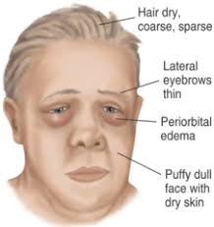
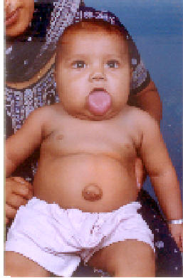
Cretinism
Hypothyroidism developed in infancy or early childhood , either due to dietary iodine deficiency or enzymatic defect
impaired development of the skeletal system and central nervous system, severe mental retardation, short stature, coarse facial features, a protruding tongue
Myxedema
Hypothyroidism developed in older children and adults. generalized fatigue, apathy, mental sluggishness, which may mimic depression

Slide 8
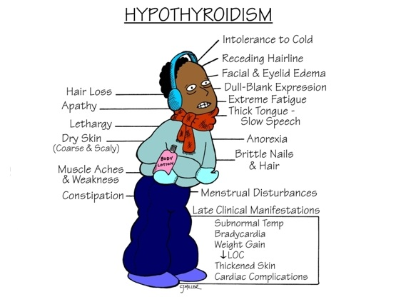

Slide 9
Autoimmune thyroid diseases
Autoimmunity is the underlying cause of a variety of thyroid diseases, which are collectively referred to as autoimmune thyroid disease (AITD). Which include thyroiditis, and antibody-mediated disturbances in thyroid function that are not necessarily associated with inflammation
Thyroiditis is a diverse group of disorders characterized by some form of thyroid inflammation. the three most common and clinically significant subtypes: (1) Hashimoto thyroiditis, (2) granulomatous (de Quervain) thyroiditis, and (3) subacute lymphocytic thyroiditis.

Slide 10
HASHIMOTO THYROIDITIS (chronic lymphocytic thyroiditis)
It is the most common cause of hypothyroidism in iodine sufficient areas .
Characterized by painless enlargement of the thyroid, usually associated with hypothyroidism because of autoimmune destruction of the thyroid gland.
May associated with other autoimmune diseases as (SLE, type II diabetes, rheumatoid arthritis)
May evolved into B-cell non-Hodgkin lymphomas within thyroid
predisposition to papillary carcinomas (controversial)

Slide 11
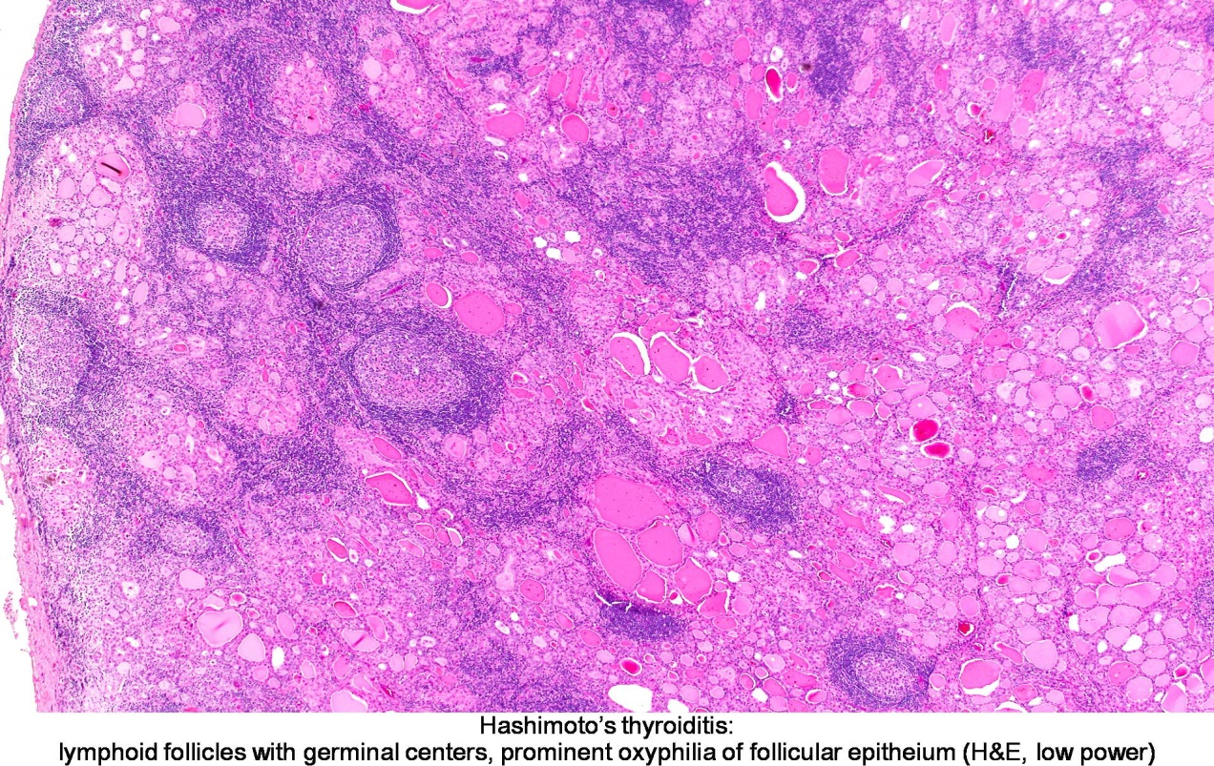
Grossly
Diffuse symmetric enlargement of thyroid gland
Microscopically
Extensive lymphocytic infiltrate lymphoid follicles with prominent germinal center formation
Fibrosis

Slide 12
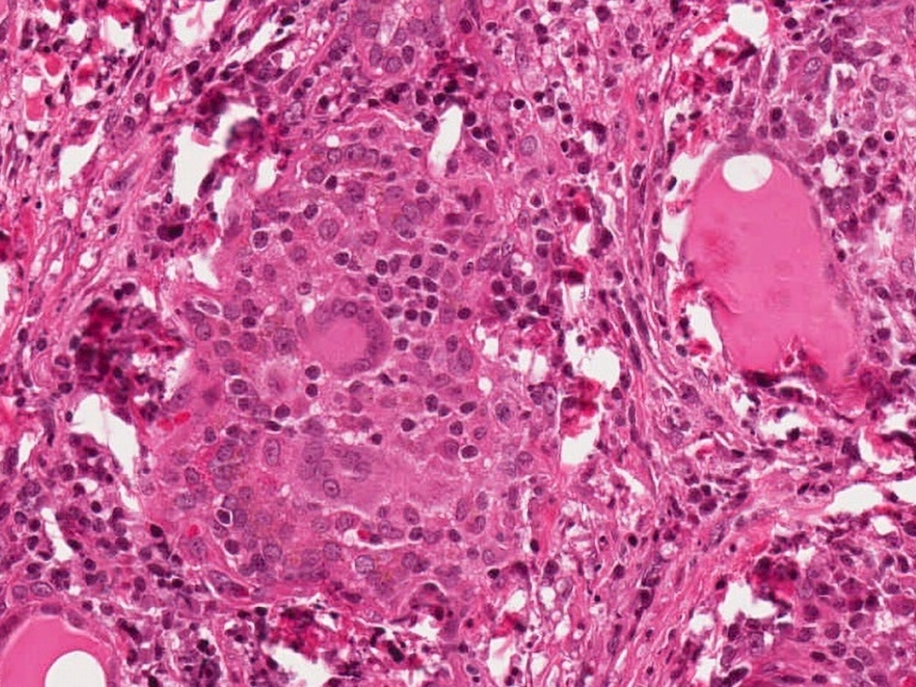
Subacute granulomatous ( de Quervain) thyroiditis
Inflammation of thyroid gland that includes granulomas formation
Much less common than Hashimoto thyroiditis
Caused by viral infection
A majority of patients have a history of an upper-respiratory infection shortly before the onset of thyroiditis
Presented with thyroid pain, Transient hyperthyroidism may occur
it is self limited disease

Slide 13
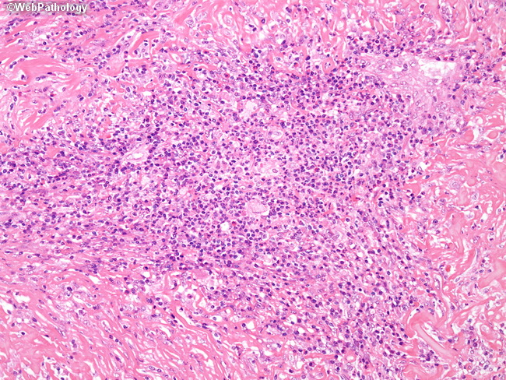
Other Forms of Thyroiditis
Riedel thyroiditis
Is a rare disorder is characterized by extensive fibrosis involving the thyroid and contiguous neck structures.
Appear as a hard and fixed thyroid mass, simulating a thyroid neoplasm.

Slide 14
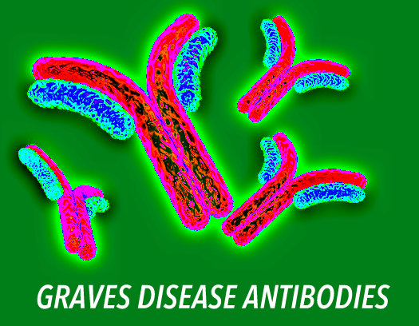
Graves Disease
Commonest cause of endogenous hyperthyroidism with a Female predominance
It an autoimmune disease in which circulating autoantibodies against thyrotropin (TSH receptor) that activates the receptor, leading to increased thyroid hormone synthesis and secretion other autoimmune disease such as SLE, pernicious anemia, type I DM

Slide 15
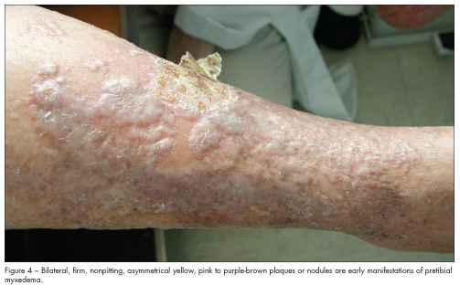
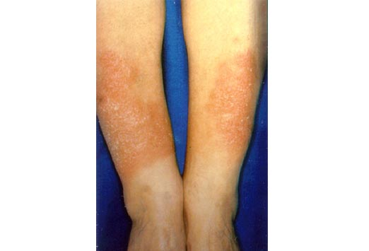
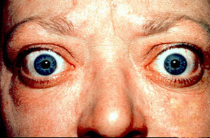
Characterized by triad of manifestations:
Thyrotoxicosis
Exophthalmos
Dermopathy (pretibial myxedema)

Slide 16
Goiter
Goiter is enlargement of the thyroid gland which is the most common manifestation of thyroid disease.
It reflect impaired synthesis of thyroid hormones, which is most often caused by dietary iodine deficiency.
Impairment of thyroid hormone synthesis leads to a compensatory rise in the serum TSH level, which, in turn, causes hypertrophy and hyperplasia of thyroid follicular cells lead to diffuse enlargement of the thyroid gland (diffuse goiter)
Could be endemic or sporadic

Slide 17
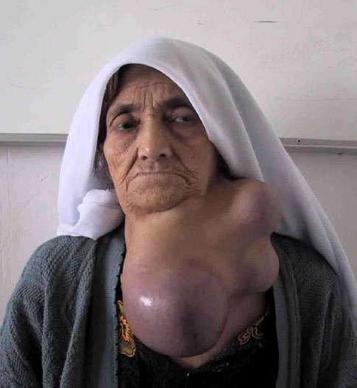
MULTINODULAR GOITER
Virtually all long-standing diffuse goiters convert into multinodular goiters with recurrent episodes of hyperplasia
It is hormonally silent ,thyrotoxicosis secondary to the development of autononmus nodules that produce thyroid hormone (toxic MNG)
Risk of malignancy is low

Slide 18
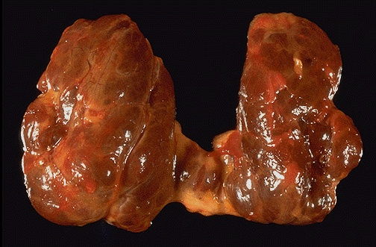
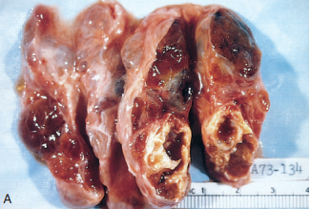
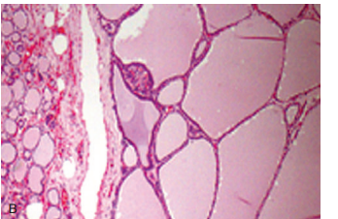
Grossly
asymmetrically enlarged glands reaching a massive size. On cut surface, irregular nodules containing variable amounts of brown, gelatinous colloid
Areas of hemorrhage , calcification and cystic changes
Microscopically
colloid-rich follicles lined by flattened, inactive epithelium and areas of follicular epithelial hypertrophy and hyperplasia

Slide 19
Neoplasms of The thyroid gland
Thyroid neoplasm ranging from benign adenoma to highly aggressive ca. several clinical criteria provide a clue to the nature of thyroid nodule: 1.Solitary nodule neoplastic 2. Nodules in very young(less than 20) or very old (more than70) individuals are more likely to be neoplastic 3.Nodule in male neoplastic 4.A history of radiation to head and neck carcinoma. 5.Hot nodule that take up iodine in imaging neoplastic

Slide 20
Follicular Adenomas
Benign tumor of thyroid derived from follicular epithelium
Clinically, follicular adenomas difficult to distinguish from other causes of solitary thyroid nodule which could be (simple goiter, dominant nodule of multinodular goiter, thyroid cyst, foci of thyroiditis and follicular carcinoma )
Mainly nonfunctional, a small proportion produces thyroid hormones and causes thyrotoxicosis.
Careful evaluation of the integrity of the capsule is therefore critical in distinguishing follicular adenomas from follicular carcinomas.

Slide 21
Morphology.
Solitary, tan-light brown encapsulated mass
Well demarcated from the adjacent thyroid tissue by a well-defined, intact capsule.

Slide 22
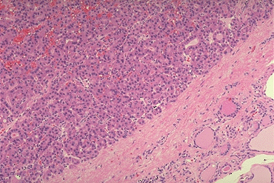
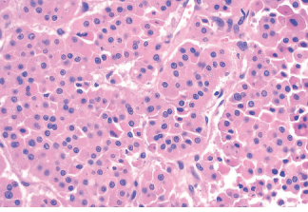
Microscopically
Uniform follicles contain colloid lined by benign cuboidal or columnar epithelium.
Occasionally, the neoplastic cells acquire brightly eosinophilic granular cytoplasm (oxyphil or Hürthle cell change)
Intact, well-formed capsule encircling the tumor
colloid
Tumor mass
follicles
Intact tumor capsule
Normal thyroid tissue

Slide 23
Thyroid Carcinomas
The major subtypes of thyroid carcinoma
Most thyroid carcinomas (except medullary carcinomas) are derived from the thyroid follicular epithelium
Papillary carcinoma (>85%)
2. Follicular carcinoma 3. Hurthle cell carcinoma
4. Anaplastic (undifferentiated) carcinoma
5. Medullary carcinoma . arise from parafollicular C cells. neuroendocrine tumor secreting calcitonin hormone

Slide 24
Papillary Carcinoma
Most common form of thyroid cancer..
It associated with previous exposure to ionizing radiation before the age of 20
Mostly present as asymptomatic thyroid nodule
Tendency to spread to regional lymph nodes

Slide 25
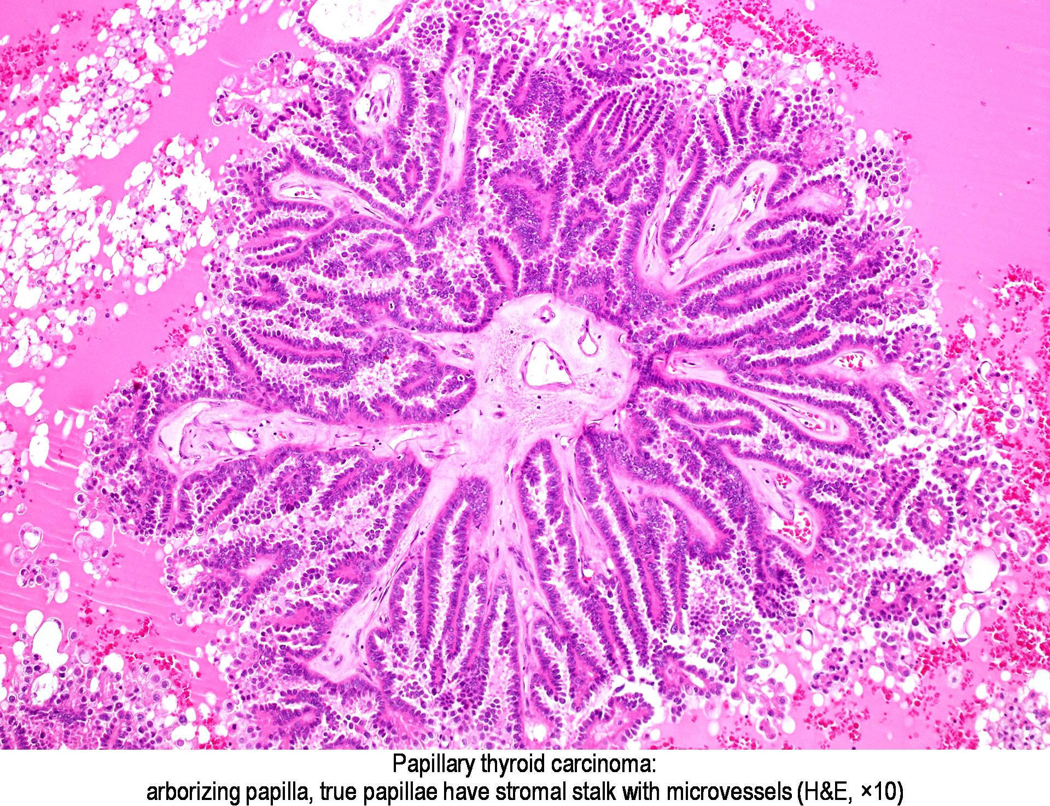
Microscopically
Papillae having a fibrovascular stalk covered by single or multiple cuboidal epithelium. The diagnosis of papillary carcinoma is made based on the nuclear features

Slide 26
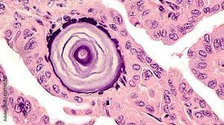
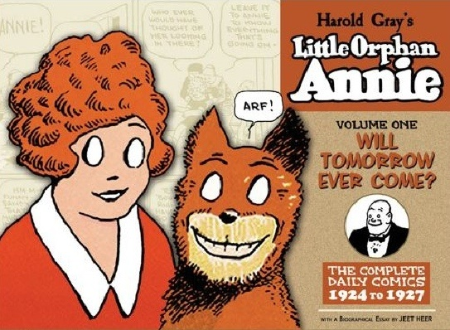
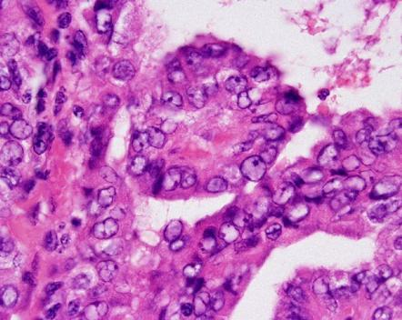
Nuclei with finely dispersed chromatin, with an optically clear or empty appearance; ground glass nuclei or (Orphan Annie nuclei)
Concentrically calcified structures termed psammoma bodies are often present within the lesion,

Slide 27
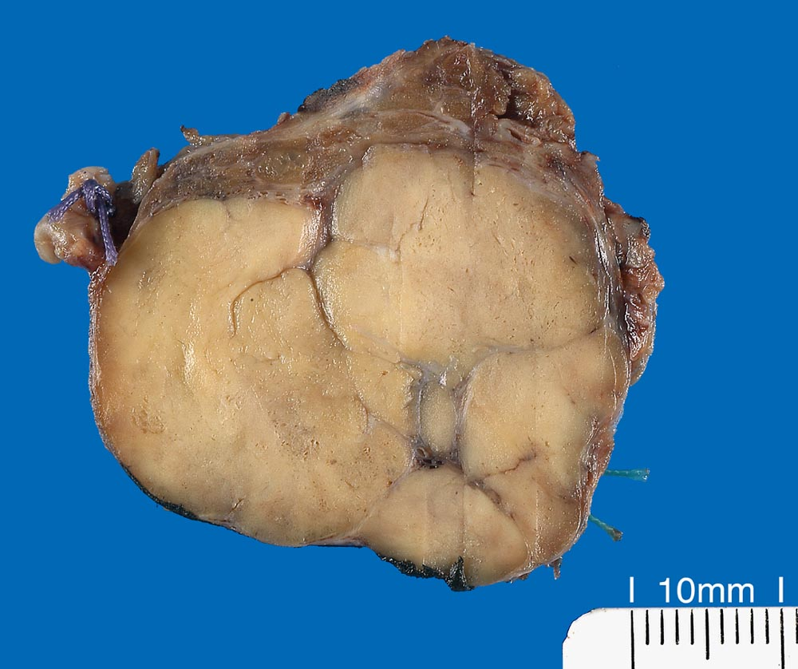
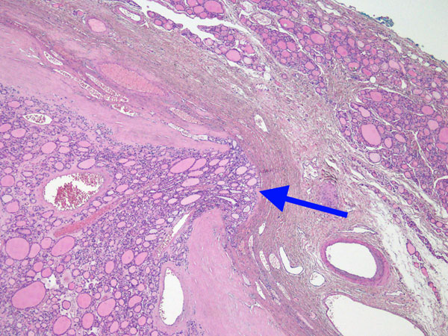
Follicular carcinomas
Common in areas with dietary iodine deficiency, common in older womwn
Microscopically
Small follicles containing colloid
Capsular invasion with invasion to adjacent thyroid tissue

